Slide 1
Hackathon 2024: DATA DRAGONS

Slide 2



TEAM NAME: DATA DRAGONS
GOKUL P
Semester: S8
Department: CSE DEPT
Area of interest: Machine Learning, LLMs
ANURAG CHANDRA
Semester: S8
Department: CSE DEPT
Area of interest: Full stack development,ML, LLMs
ATHUL MENON
Semester: S8
Department: CSE DEPT
Area of interest: Machine Learning

Slide 3


TEAM NAME : DATA DRAGONS
GOPIKA BABU
Semester: S8
Department: CSE DEPT
Area of interest: Machine Learning,Data Analytics
DIVYA DEVARAJ
Semester: S6
Department: CSE DEPT
Area of interest: Machine Learning,AI

Slide 4
LLM Business Problem: What
Small and medium-sized enterprises struggle to leverage their databases due to a lack of technical knowledge among shopkeepers, hindering optimization of product strategies and decision-making processes.Thus,there is a pressing need to develop a solution that enables SMEs to effectively harness their databases, enabling informed product management and strategic decision-making.

Slide 5
LLM Problem Statement: Why
Accessibility:Guarantees accessibility for all SMEs, irrespective of technical knowledge, facilitating smoother operations and widespread adoption.
Efficiency: SMEs benefit from streamlined database management, improving productivity and decision-making with real-time interaction in regional languages.
User Experience: The tool delivers a seamless user experience, enabling effortless interaction and satisfaction among SMEs through a user-friendly interface and language accommodation.

Slide 6
Solution Overview: How
DragonSense AI ,an tool to help SMEs monitor their inventory database which enables the shopkeepers to talk with AI.The AI can give insights about the purchases and the status of the products. The tool can be integrated with the existing database (billing software will be using a database). So we hope by using this AI the shopkeepers can actually increase their profit by getting useful insights with ease and less time consumption.

Slide 7
Solution Overview: How
DragonSense AI is implemented using the following:
LangChain: Langchain provides two key components for natural language-powered database interactions:
SQLDatabase: Establishes a connection to your database.
SQL DatabaseChain: Combines the SQLDatabase instance with a large large language model(LLM)for text-to-SQL conversion
Google Generative-AI: Text Bison: For text-to-SQL conversion within the SQLDatabaseChain.
Machine Learning: For text to speech and speech to text conversions.

Slide 8
Economic Logic
Enhanced Efficiency: DragonSense AI streamlines inventory management processes, reducing manual effort and time spent on tracking stock, updating databases, and generating reports.
Improved Decision-making: Shopkeepers gain access to real-time insights about their inventory, including stock levels, expiry dates, and product performance. This enables informed decisions on stock replenishment, pricing strategies, and product selection
Cost Savings: By optimizing inventory levels and reducing wastage through better stock management, shopkeepers can minimize inventory holding costs and potential losses due to expired products.

Slide 9
Economic Logic
Enhanced Customer Satisfaction: By ensuring product availability and freshness through effective inventory management, shopkeepers can improve customer satisfaction and loyalty, leading to repeat business and positive referrals.
Focus on Growth: By automating routine inventory tasks and providing actionable insights, DragonSense AI frees up shopkeepers' time to focus on strategic activities aimed at growing their business and expanding their market reach.
Revenue Optimization: With a clearer understanding of which products are selling well and which ones are less profitable, shopkeepers can adjust their product offerings to focus on high-demand items, thereby maximizing revenue potential.

Slide 10
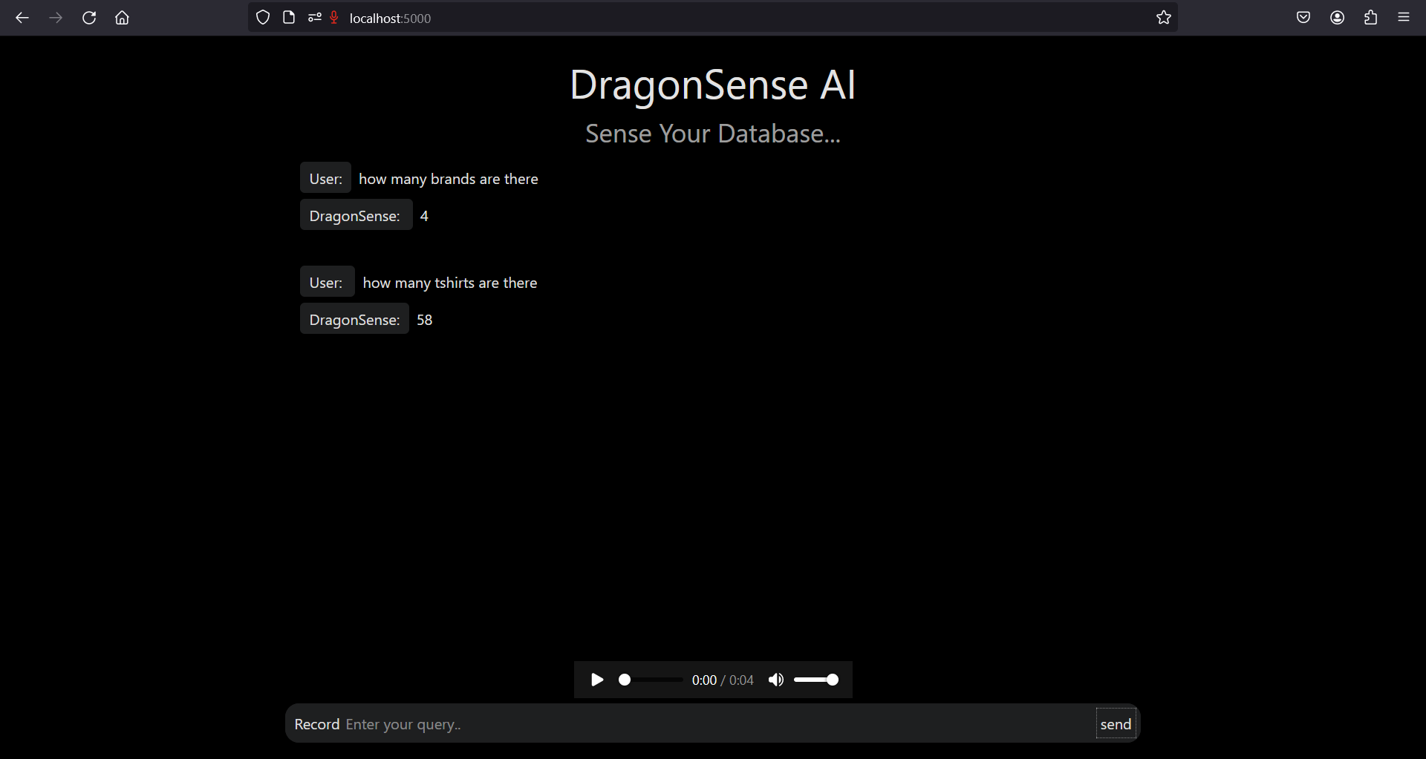
Project Demo

